Slide 1
HxH Tracking System
Chenyu

Slide 2
Overview
User groups: Supervisors and Administrator.
System: Meteor framework & Mongo database
Security: Only run inside the internal network, database will be stored in main server. The data manipulation is all on server side.
Three Main functions: 1. Hourly automatically produce and record data. 2. able to stop at any time to change over 3. Generate reports

Slide 3
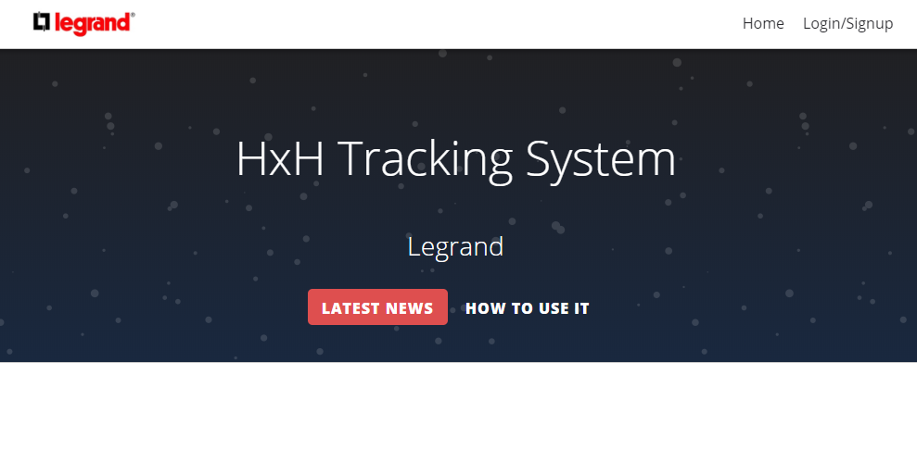
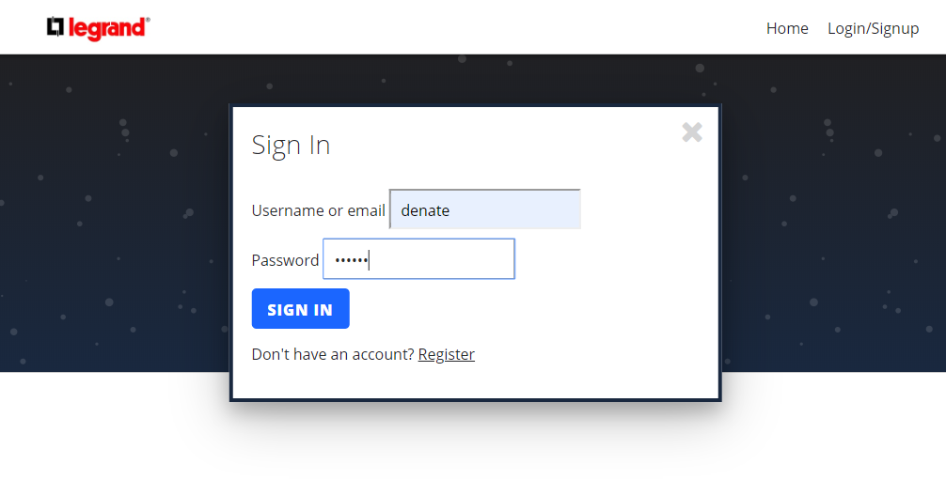
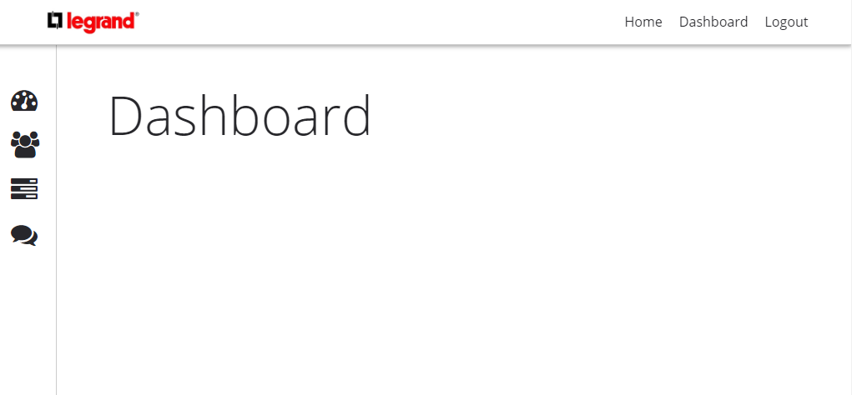
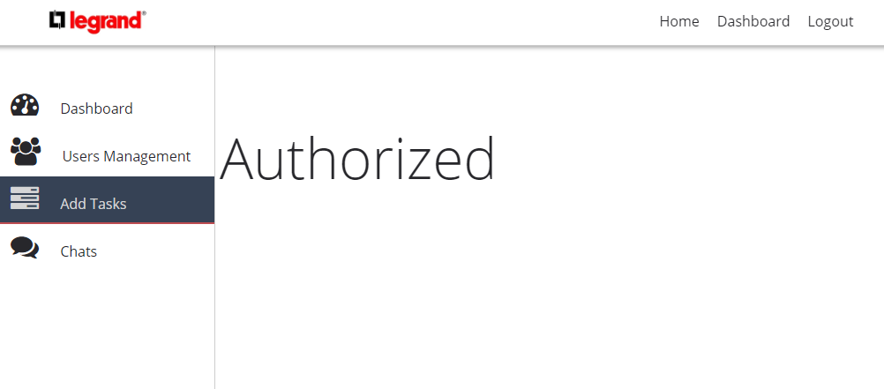

Slide 4
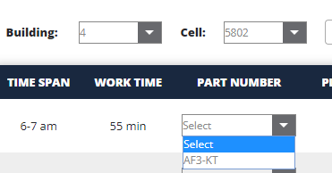
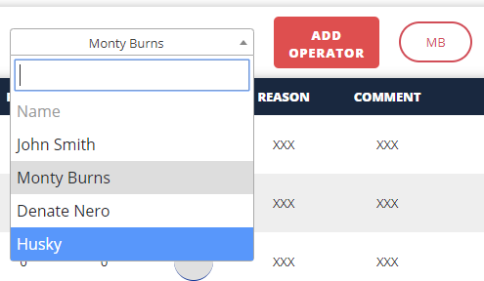
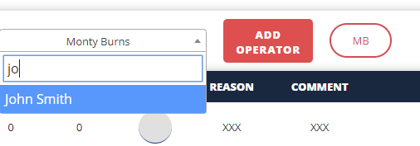


First step for operators: 1. select the building and cell; 2.add or delete name. 3. select the part number. 4. the Plan number will change according to equation:

Slide 5
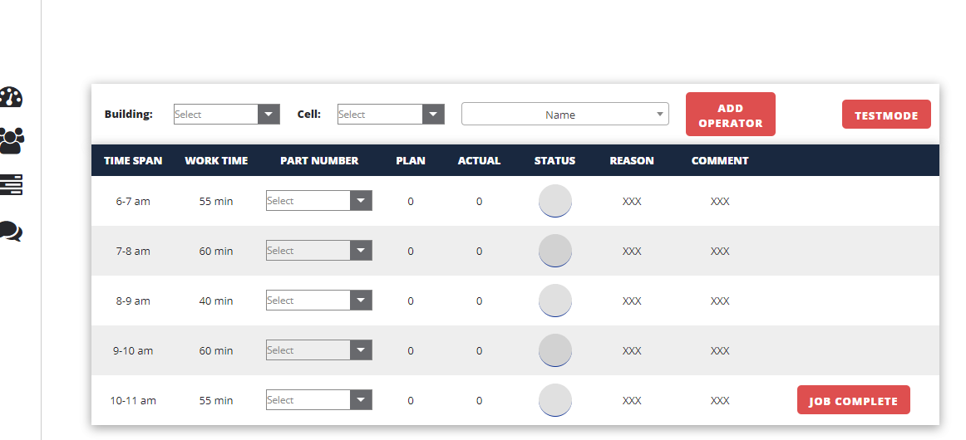
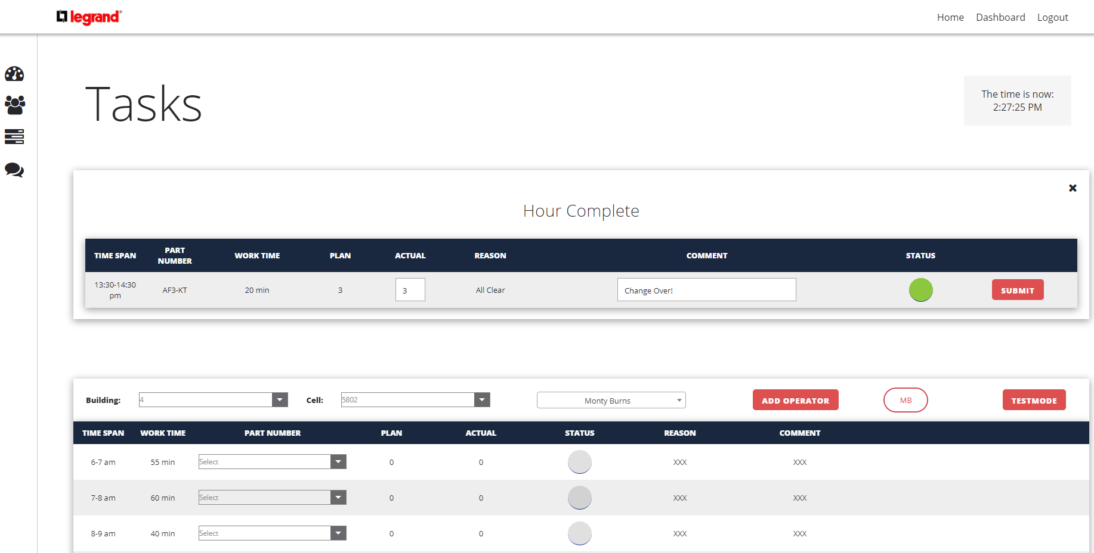
Secondly, under normal situation, the Hour complete box will pop up when time hits

Slide 6
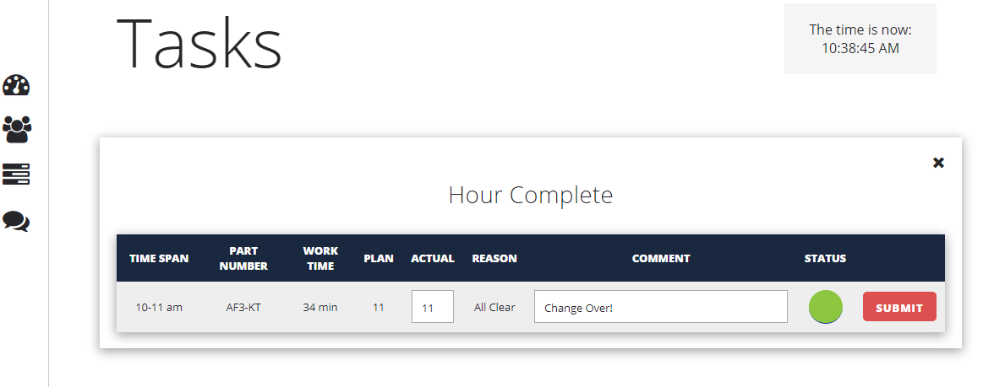
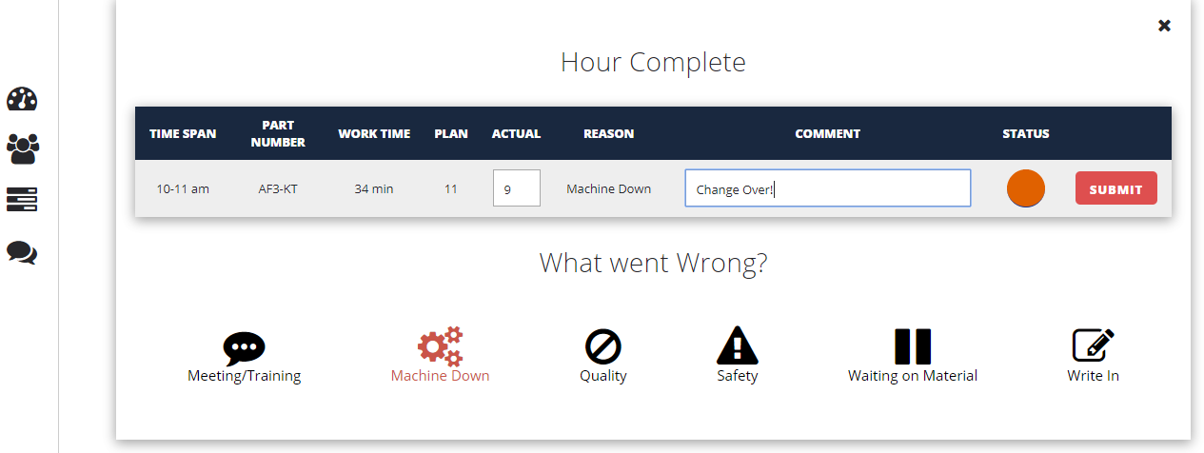
Thirdly, the operator need to fill the form up, they are supposed to input the actual pieces they have done, the comments(optional), the status and the reason if the status is red

Slide 7
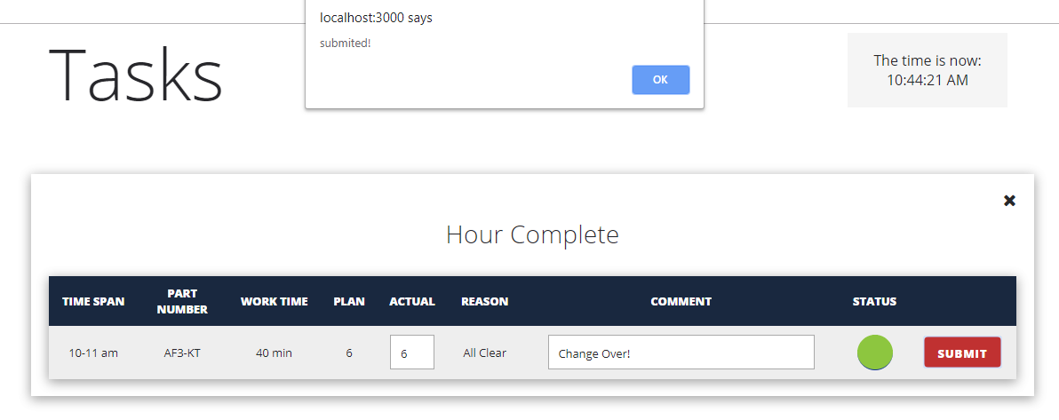
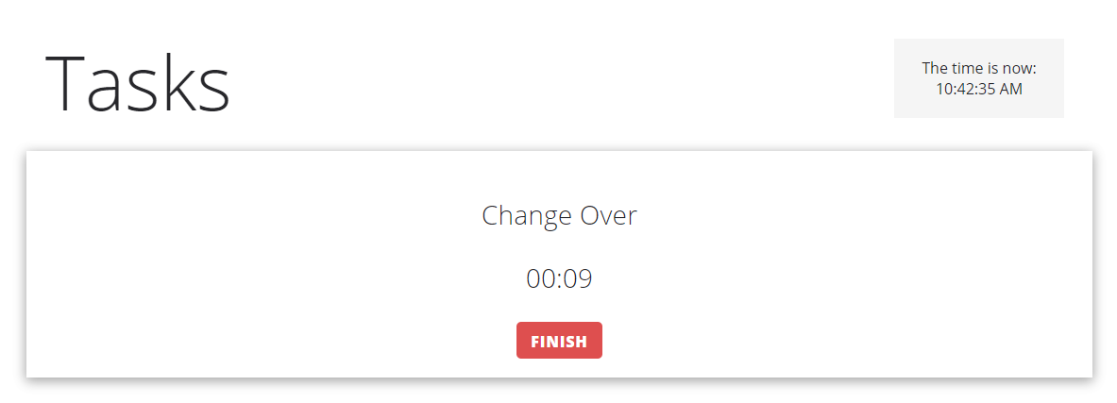
Or, operator can finish their job at any time in the time span when they are going to change over.

Slide 8
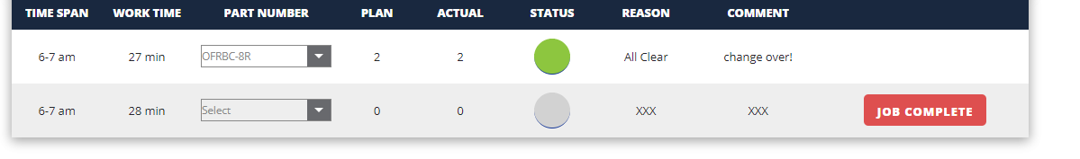
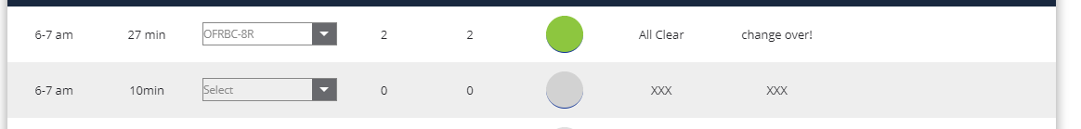
How Work Time Changed
Note: In this example the change over time is counted by the timer and the value is 18 min.

Slide 9
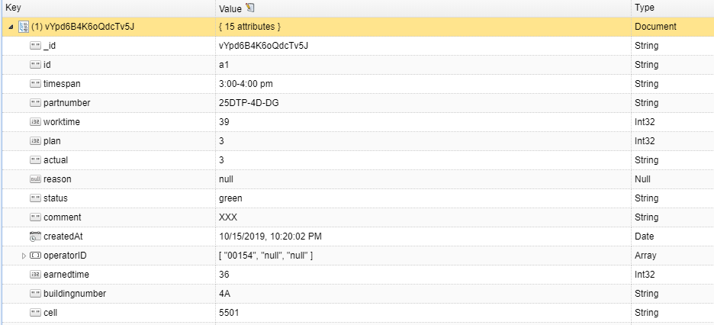
Data Structure

Slide 10
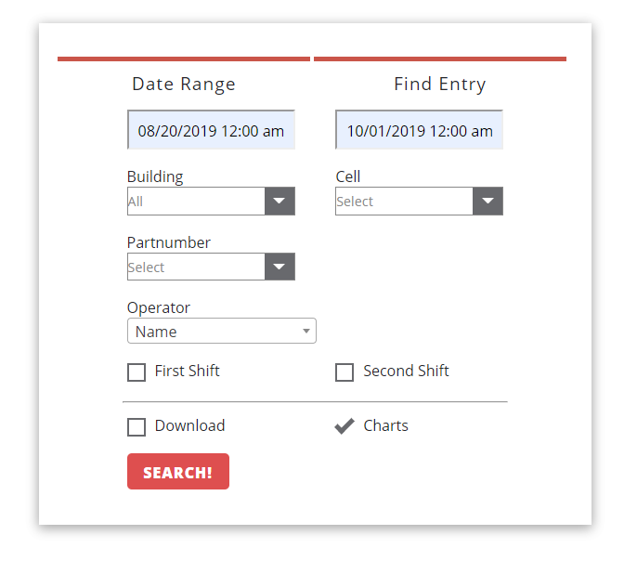
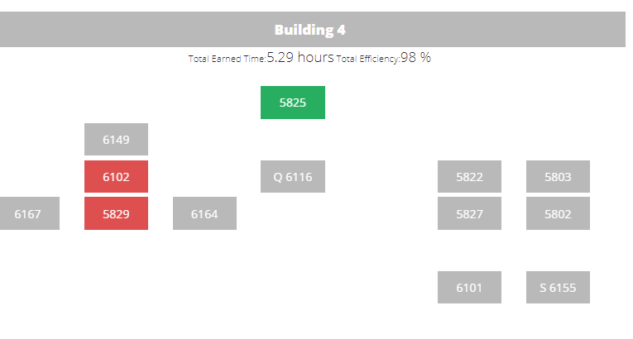
Generate Reports and Heatmap

Slide 11
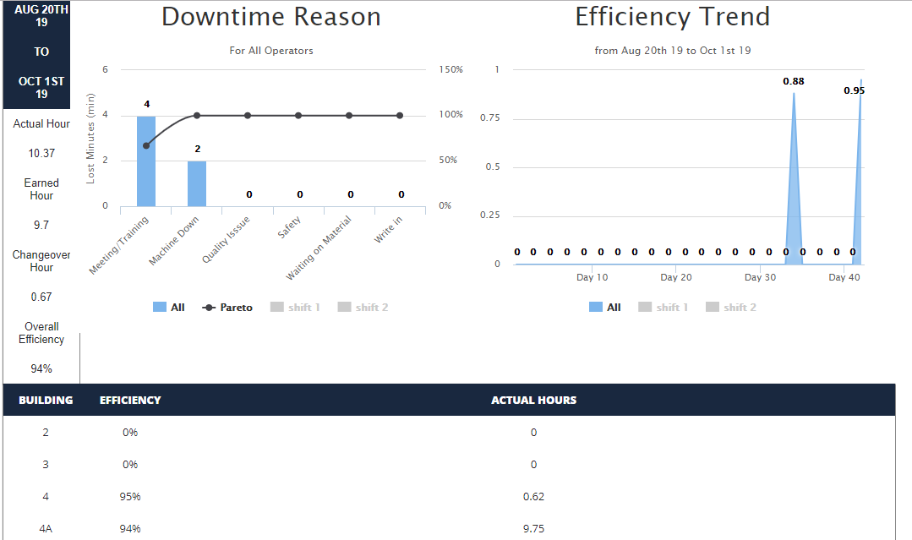

Slide 12
Thank you!

Slide 13
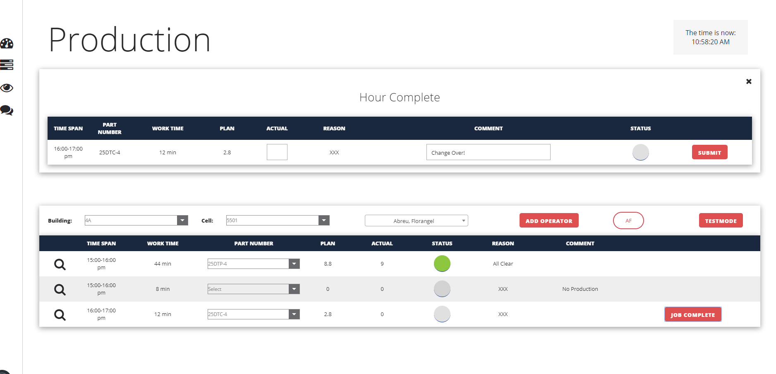

Slide 14
